Slide 1
Operating Systems
Dr. Deepak Dembla

Slide 2
Process Management

Slide 3
Objectives
Difference between job, program, task and process
Implicit and non-implicit processes
Process environment
Life cycle of a process with its states and state transitions
Implementation of Processes with process control block
Context switching
Process switching
Process schedulers
Various operations on processes

Slide 4
Program and Job used in batch systems.
Program is classical term used for user’s computation
Job is a sequence of single programs
Program and Job

Slide 5
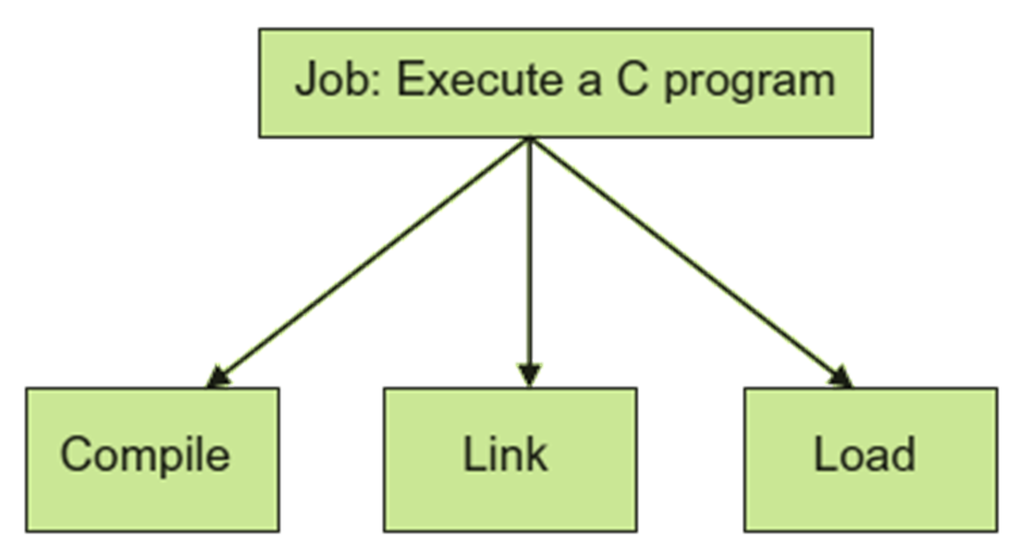
Job as a sequence of programs

Slide 6
Program/Process
program is a passive entity
program in execution is called a process
a process is able to compete for resources
‘task’ was used when there was need to have concurrent execution on a single processor, i.e. more than one programs of a single user.

Slide 7
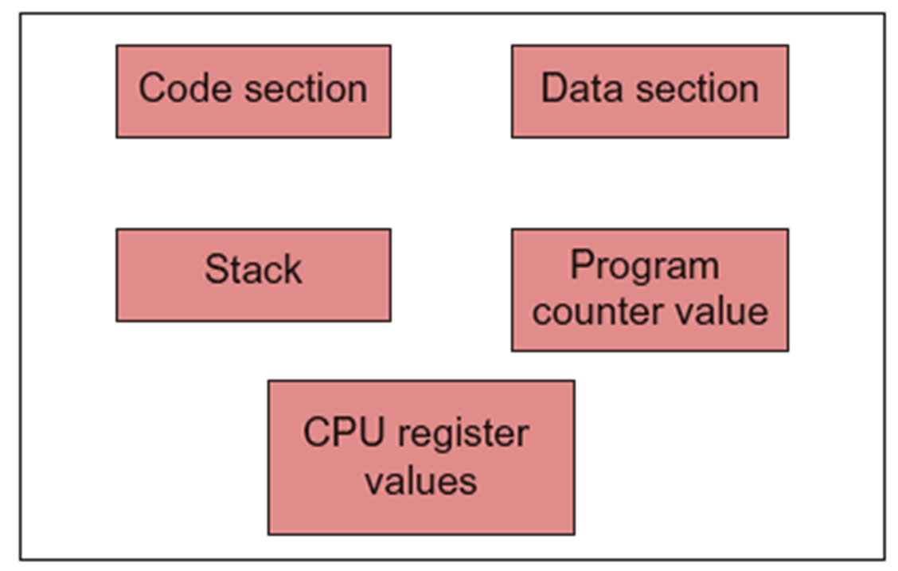
Process environment

Slide 8
Difference between program and process
Program | Process
Passive/Static | Active/Dynamic
Cannot compete for resources | Competes for resources
Has a code section | Has a code section, data section, stack, program counter

Slide 9
Types of tasks
Implicit tasks
Non-implicit tasks
Independent tasks
Cooperating tasks

Slide 10
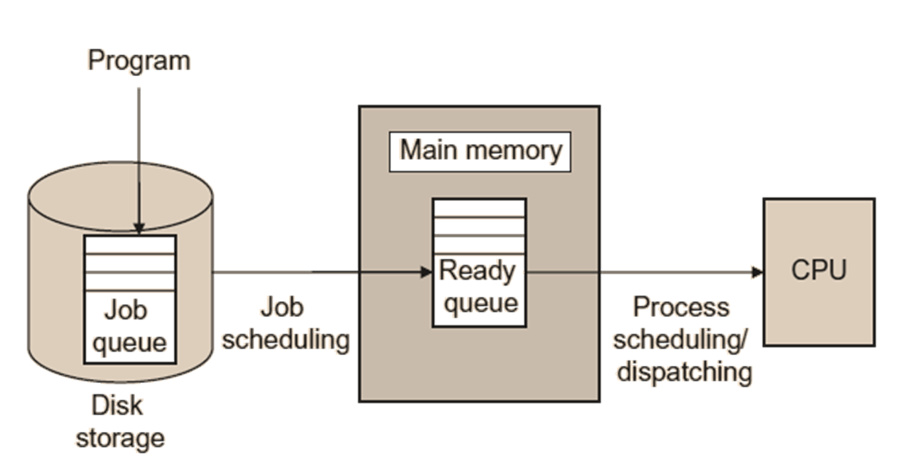
Life cycle of a process

Slide 11
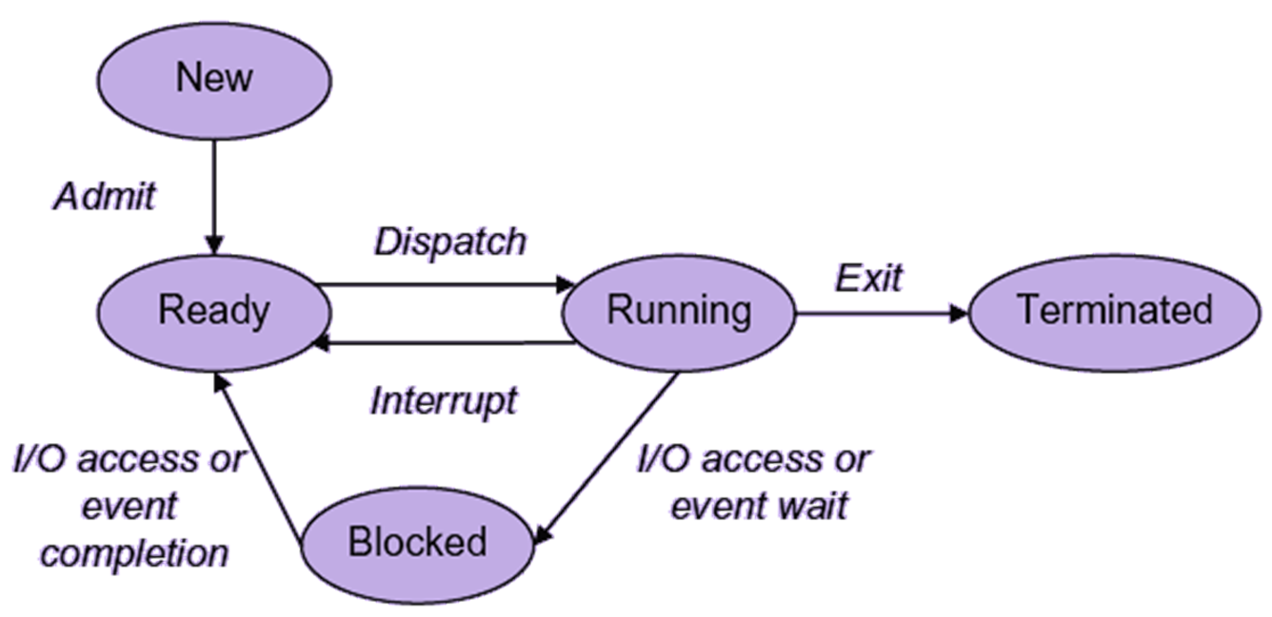
Process states and state transitions

Slide 12
Event types
Event | Current State | New State | OS Actions
A new process is created. | -- | NEW | Assigns an ID to the process and some other related information.
Process makes a resource or I/O request. | RUNNING | BLOCKED | Schedules the next process from ready queue and dispatches it to the processor.
Resource or I/O is released. | BLOCKED | READY (If the resource or I/O released is what the BLOCKED process requires) | Schedules the next process from ready queue and dispatches it to the processor.
An interrupt is generated by another process or due to any other reason. | RUNNING | READY | Schedules the next process (interrupting process if the interrupt has come from this process) from ready queue and dispatches it to the processor.
Process reaches to its end of execution or aborted. | RUNNING | TERMINATED | Schedules the next process from ready queue and dispatches it to the processor.

Slide 13
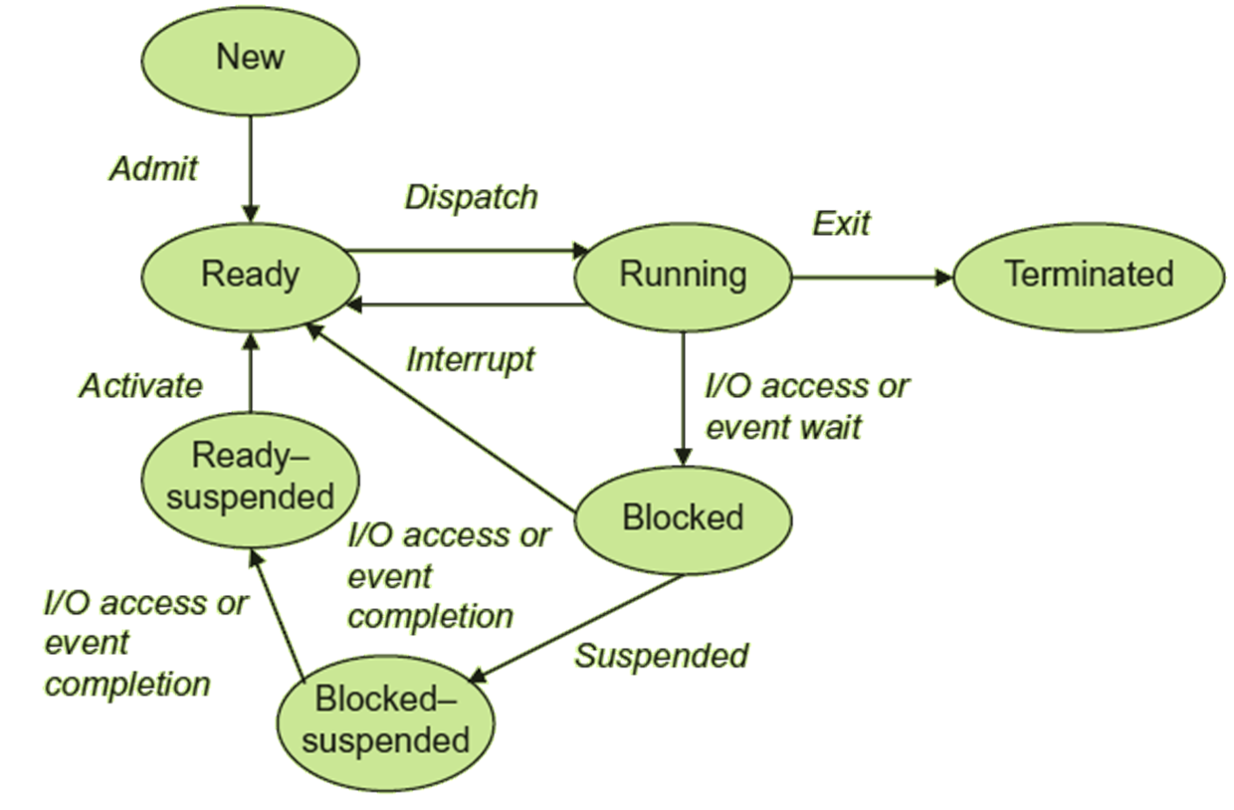
Process state diagram with suspended states

Slide 14
The following are the fields associated with a PCB:
Process control block
PID
PC
Registers
State
Priority
Event information
Memory related information
Scheduling related information
Pointer to parent process
Pointer to child process
Pointer to address space of the process

Slide 15
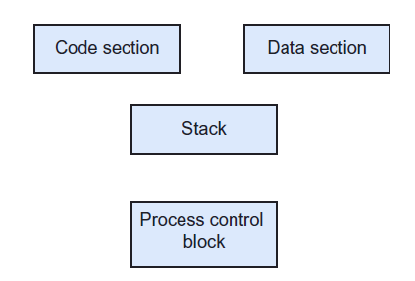
Process image

Slide 16
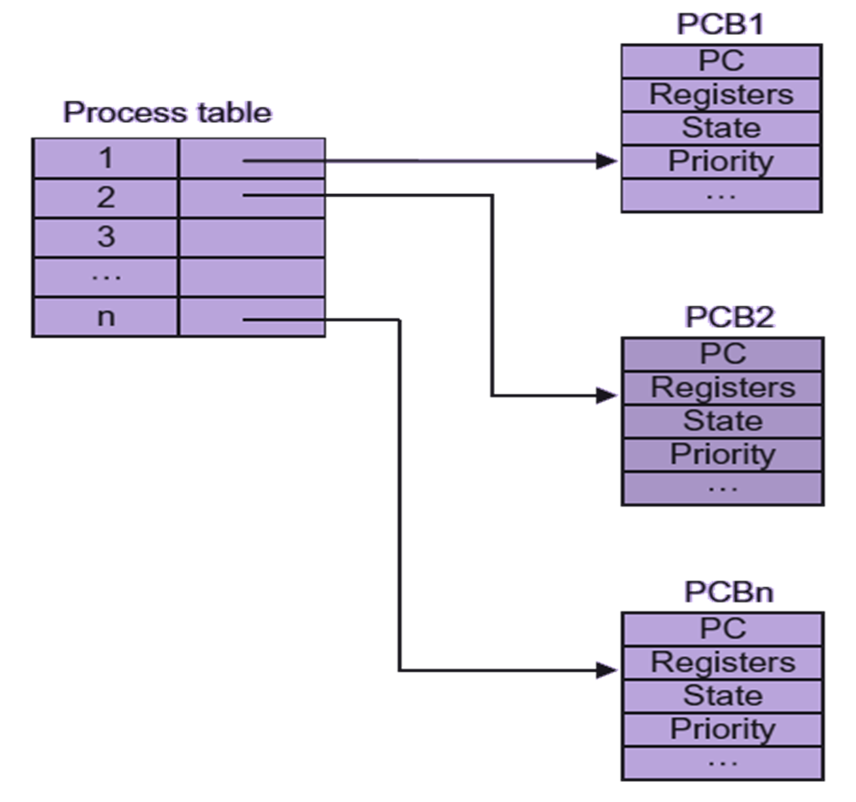
Implementation of processes

Slide 17
The various queues used here are implemented as linked lists.
There are mainly following queues:
Ready Queue for storing the processes with state ready.
Blocked queue for storing the processes which needs to wait for some I/O or resource.
Suspended queue for storing the blocked processes which have been suspended.
Free process queue for the information of empty space in memory where a new PCB can be created.
Queues

Slide 18
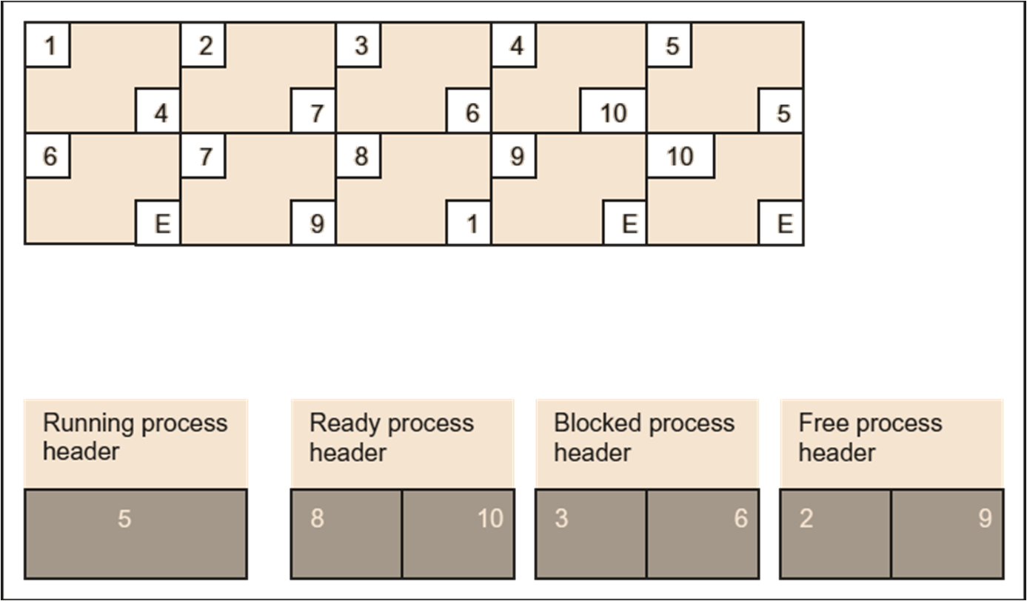
PCB queues in memory

Slide 19
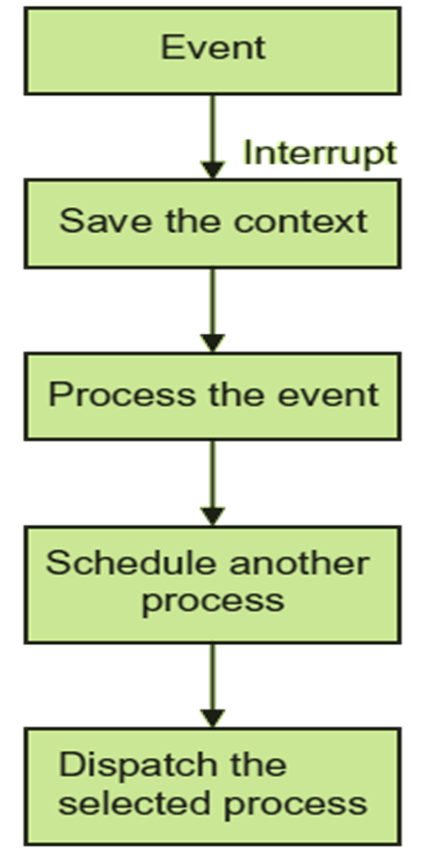
Sequence of activities during process switching

Slide 20
Long-term scheduler
Short-term scheduler
Medium-term scheduler
Schedulers

Slide 21
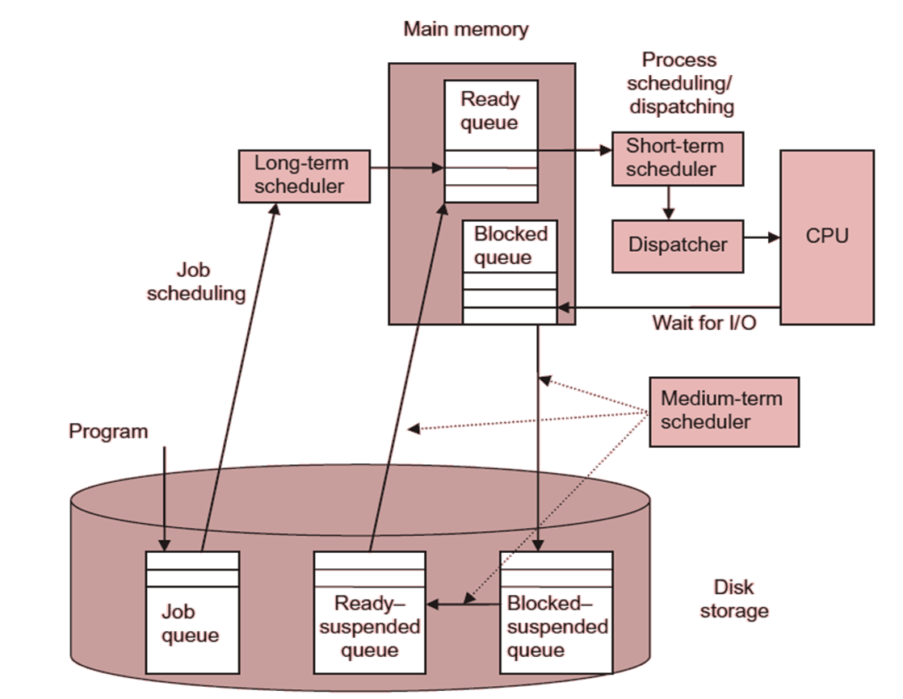
Long-term, medium-term and short-term scheduler

Slide 22
Creation
The process identification (process ID) and its priority are assigned.
The memory and other resources required by the process are allocated to it.
The code is copied in the code area, thereby setting the process environment.
The operating system looks for a free PCB space in the free-process queue for the newly created process and initializes all its fields.
An existing process may also create another process. This is known as process spawning.
Process operations

Slide 23
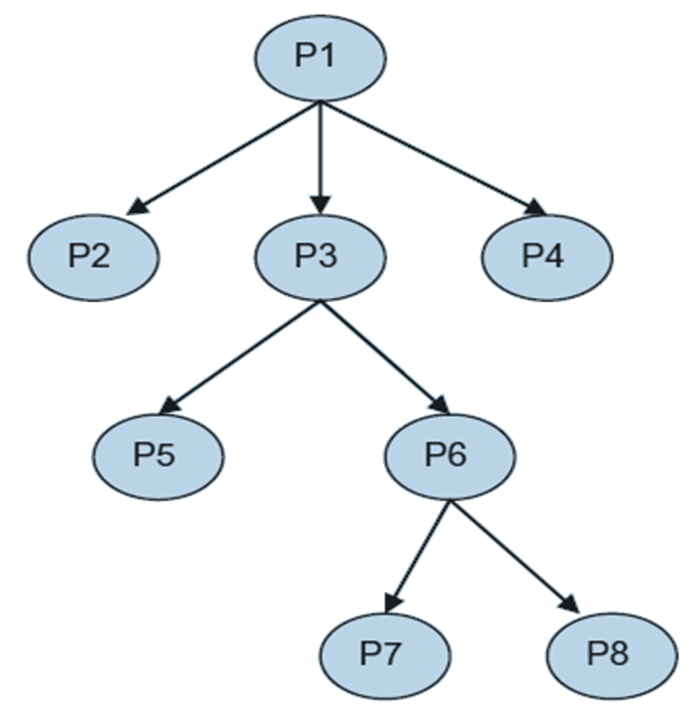
Process Hierarchy

Slide 24
When a process terminates, the memory occupied, open files, and other resources are taken away from it.
Another reason for the termination of a process may be some error or exception generated in the execution of the process. It may be the case that process may require more memory than allowed. reference a memory location out of its limits.
Try to access a resource or I/O that is not allowed to use. attempt an arithmetic operation that is not allowed, e.g. divide by zero. find an error while accessing an I/O. child process termination
Termination

